Slide 1


Docker-Assignment
By : Shashikant Tanti

Slide 2
Content
Set up Virtual Cloud Environment
Docker Installation
Required Commands to run application
Image to be pushed on DockerHub
Docker Login
Building Pipeline
Make a build
Run Application

Slide 3
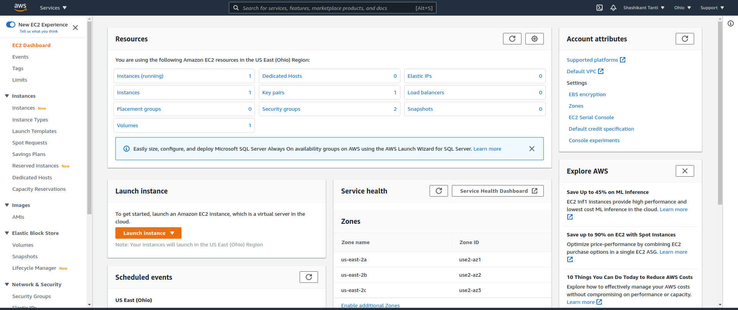
Set up Virtual Cloud Environment
Step 1- Sign in to AWS console and launch the new EC2 instance

Slide 4
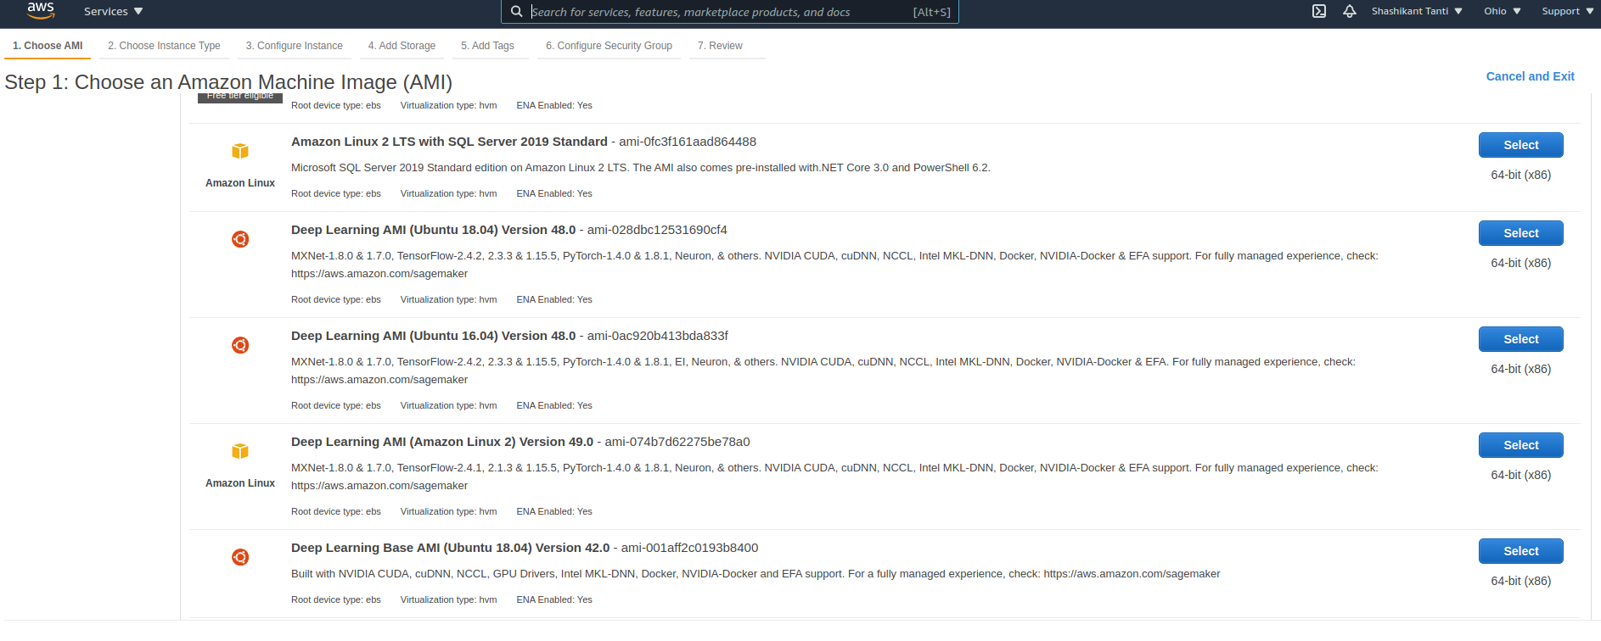
Step 2: After launching the instance select the Ubuntu Server 18.04 LTS (HVM) AMI .

Slide 5
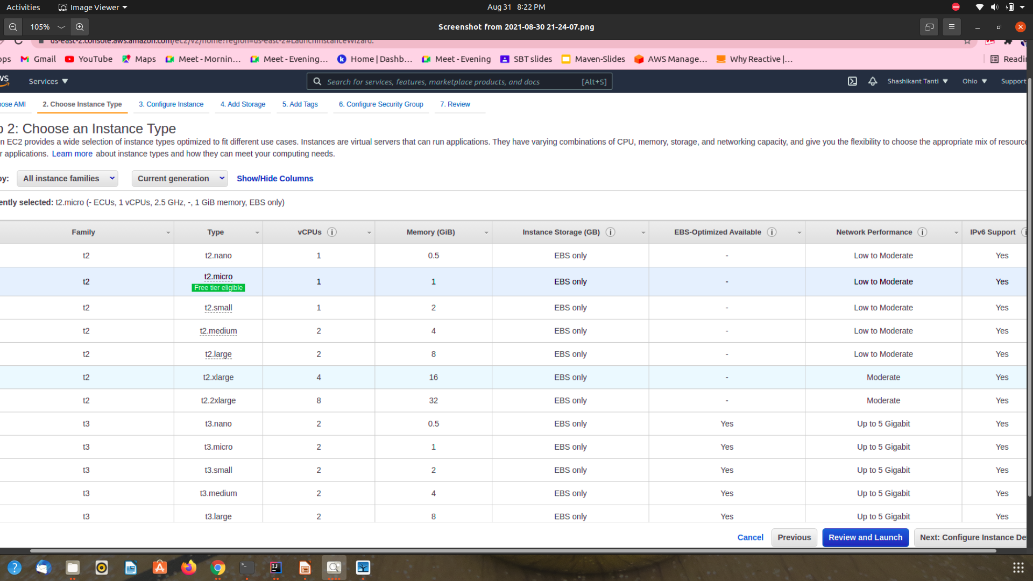
Step 3: Next choose the instance type ,configure instance details, add storage and configure security groups.

Slide 6
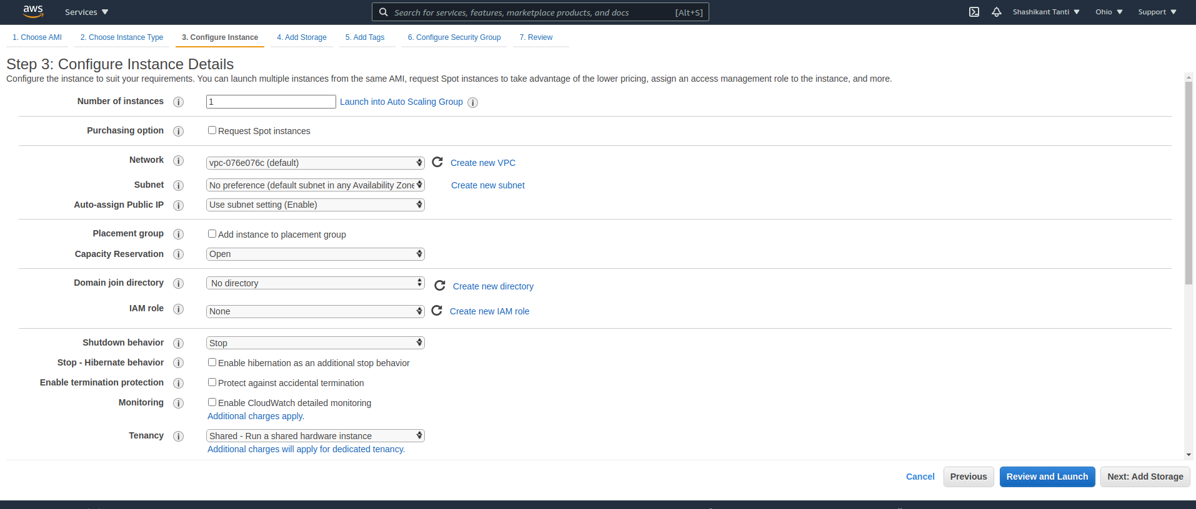

Slide 7
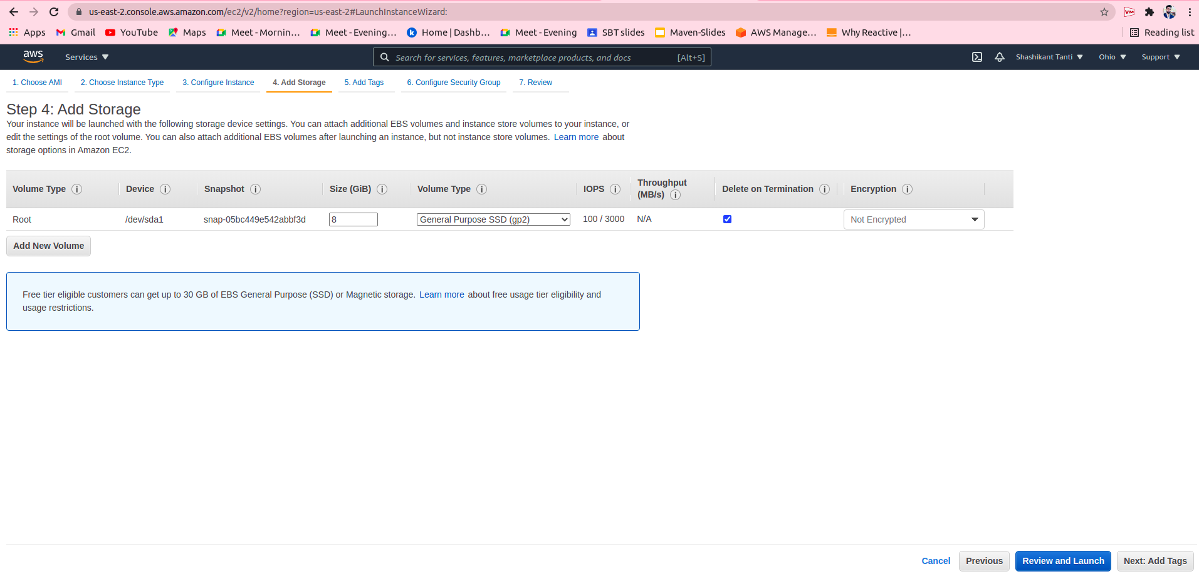

Slide 8
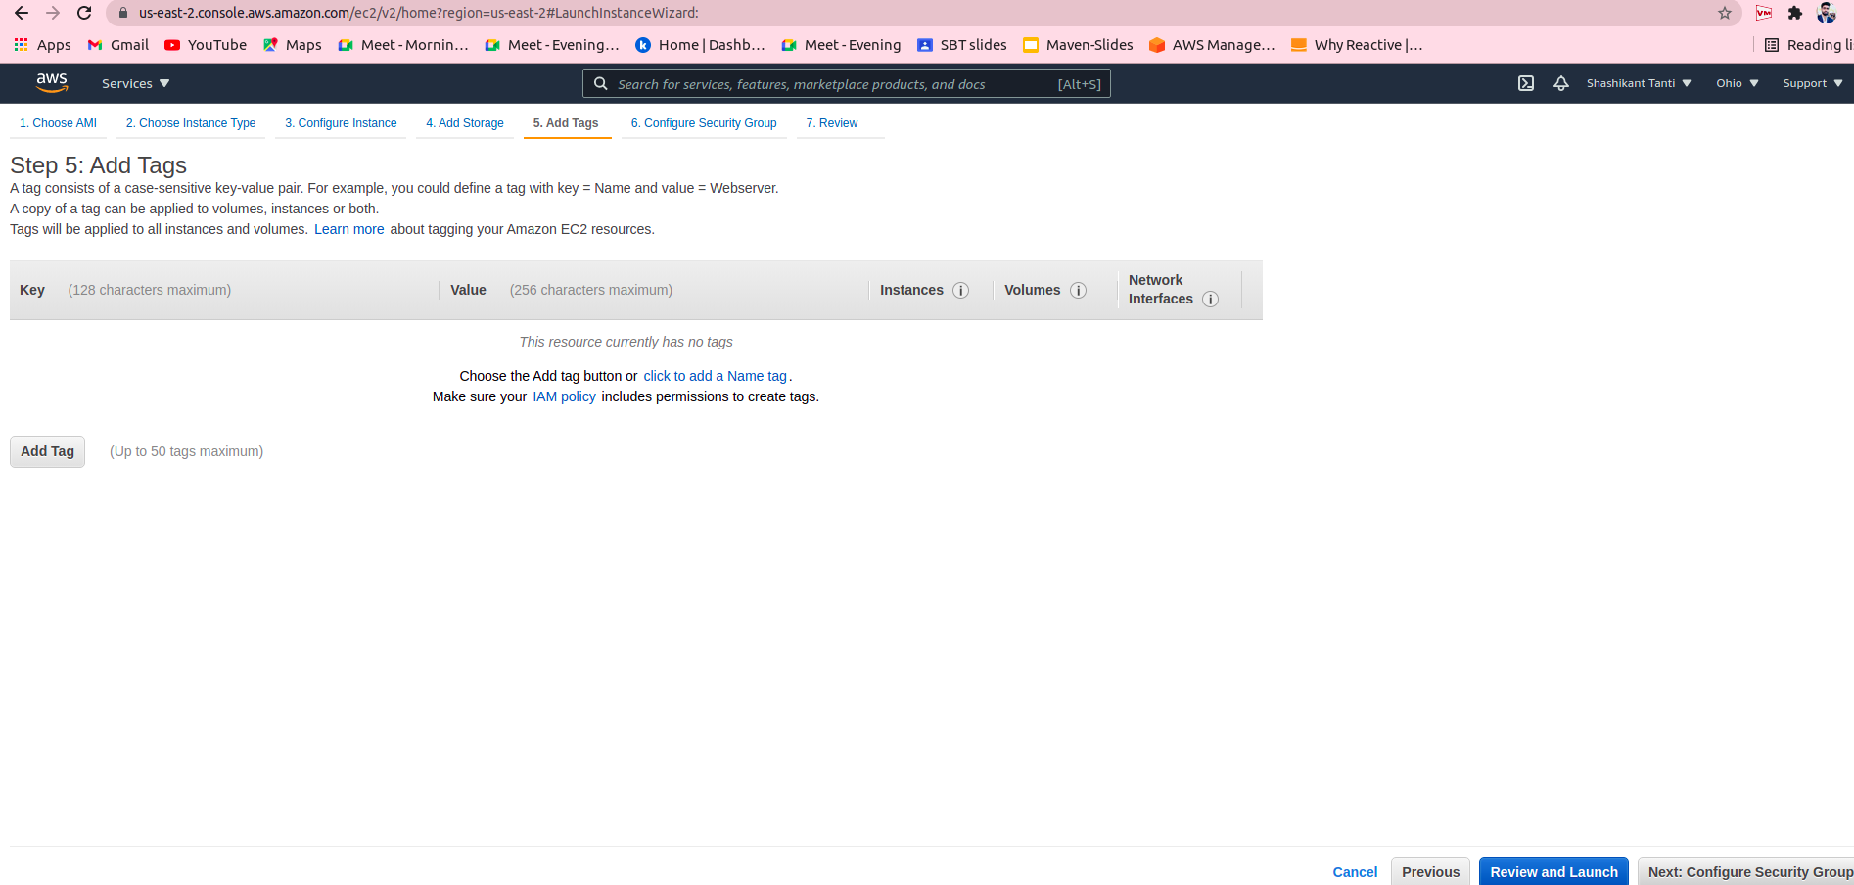

Slide 9
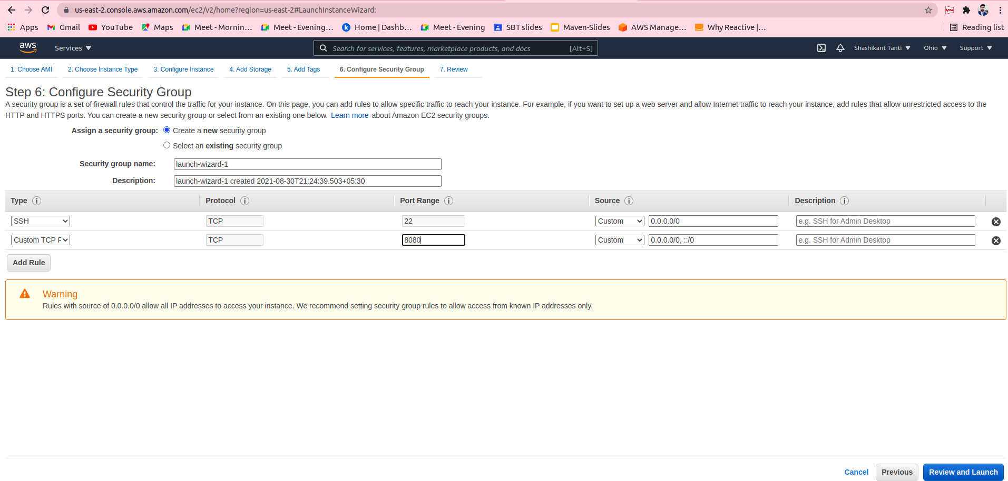

Slide 10
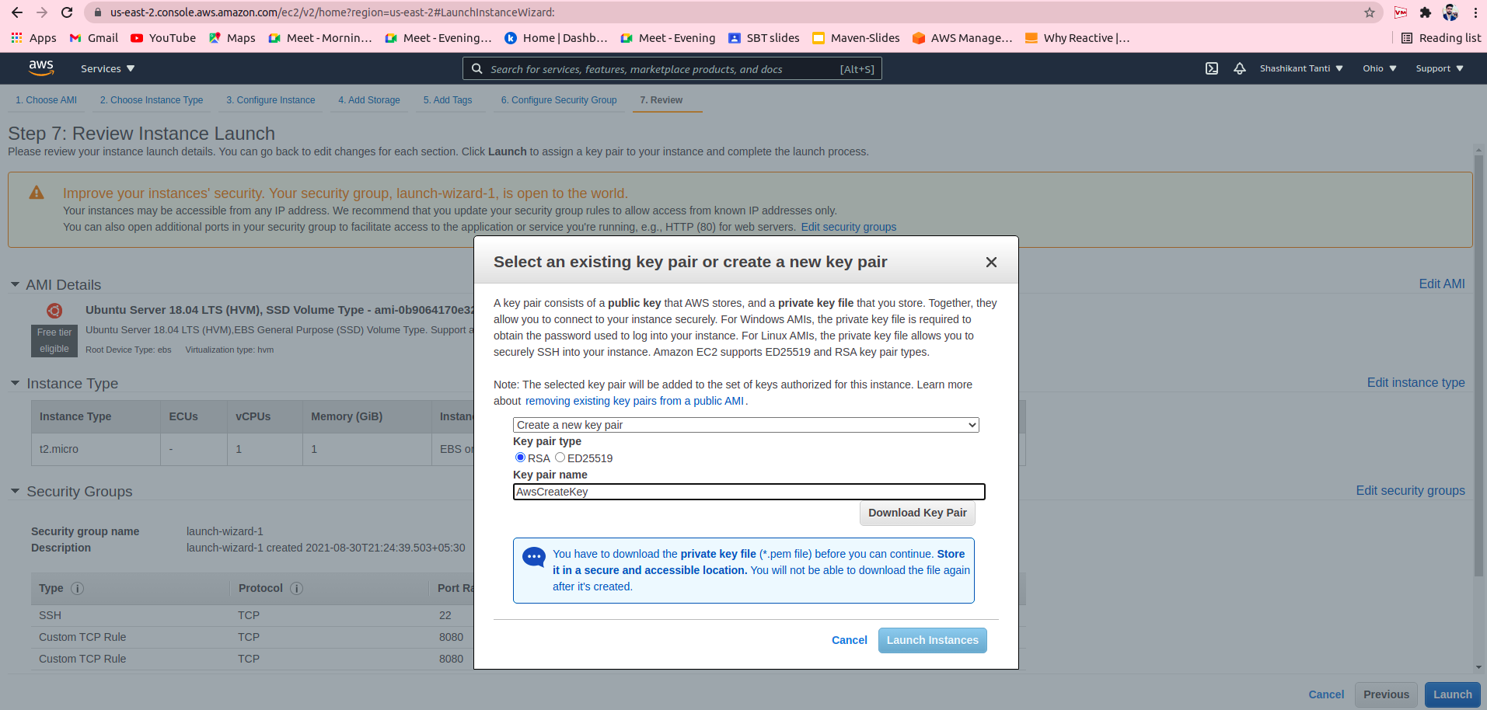
Step 4: After review launch the instance and download the key pair.

Slide 11
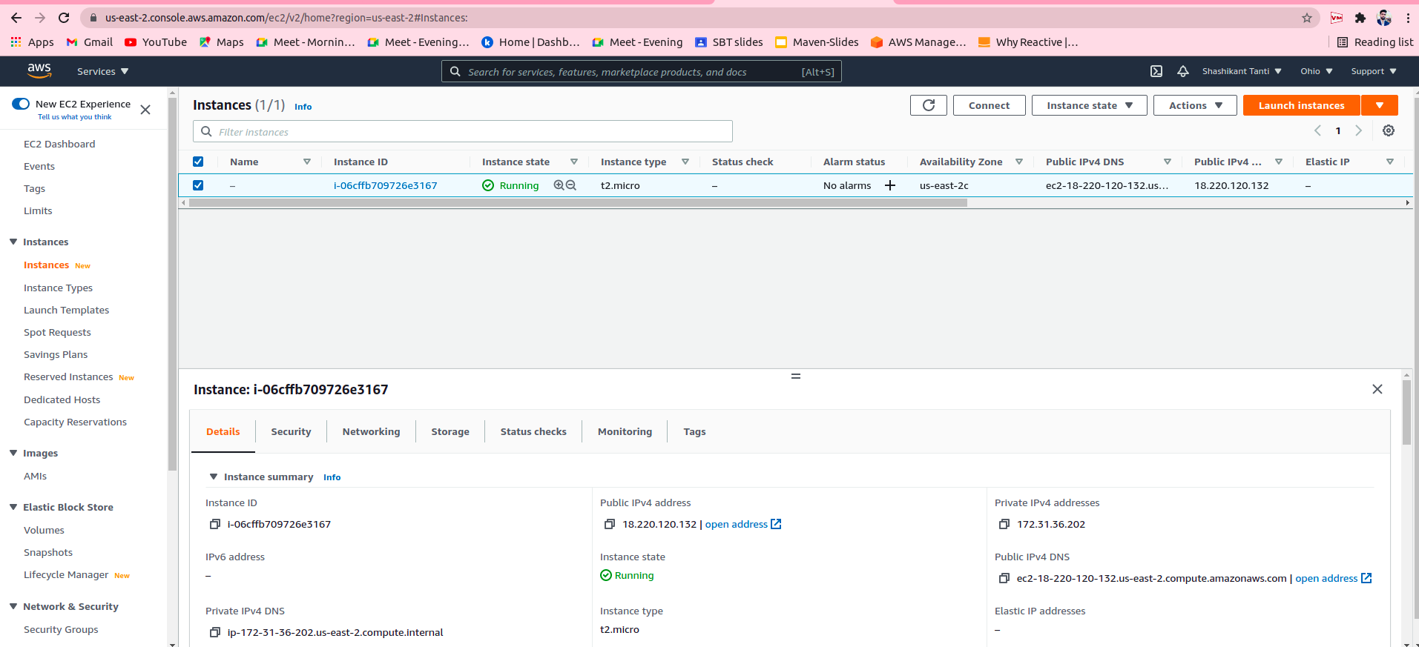
Step 5: Give the proper name to instance and copy the IP address of running instance.

Slide 12
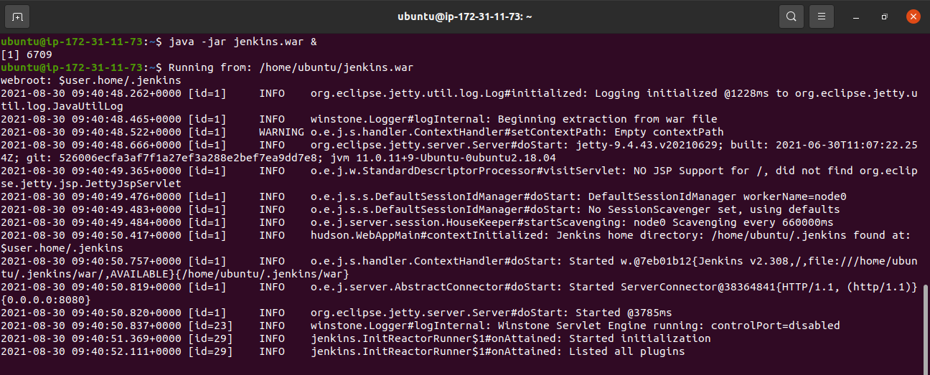
Building Pipeline
Step 6: Run the Jenkins over ec2 machine using the below command.
$ java -jar jenkins.war &
.

Slide 13
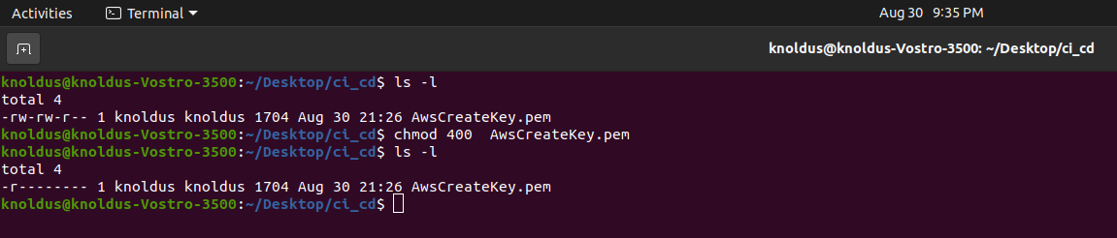
Step 7:-Open the terminal where our key pair is present and perform the following functions
Run the command - $ chmod 400 AwsCreateKey.pem , to make key publicly viewable
2. Open the ssh client using the command - $ ssh -i “AwsCreateKey.pem ” ubuntu@18.220.120.132

Slide 14
Jenkins Set up
Step 1: Get the link of the jenkins.war file from the https://www.jenkins.io/download/
Step 2: Download the jenkins war file using the command.
$ wget https://get.jenkins.io/war/2.307/jenkins.war
Step 3: Change the file permissions of jenkins.war to executable using the command.
$ chmod +x jenkins.war

Slide 15
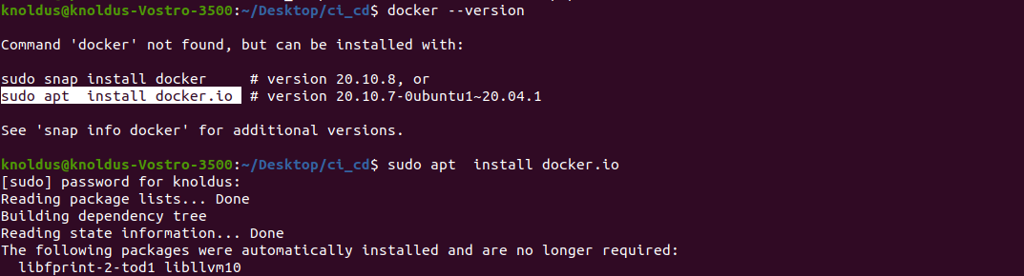
Docker Installation
Step 1: Install Docker over our virtual cloud environment using the command.
$ sudo apt install docker.io
$ docker -version

Slide 16
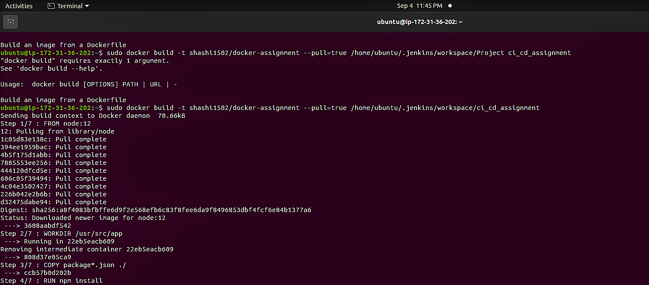

Slide 17
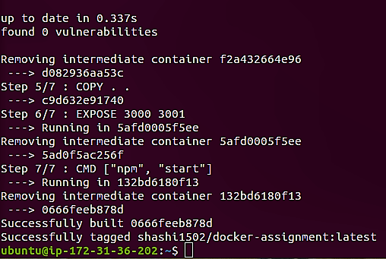
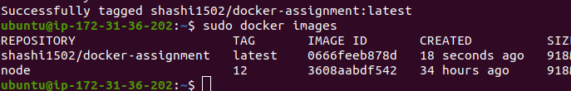
-:The image to be pushed on DockerHub and should be running on docker:-

Slide 18
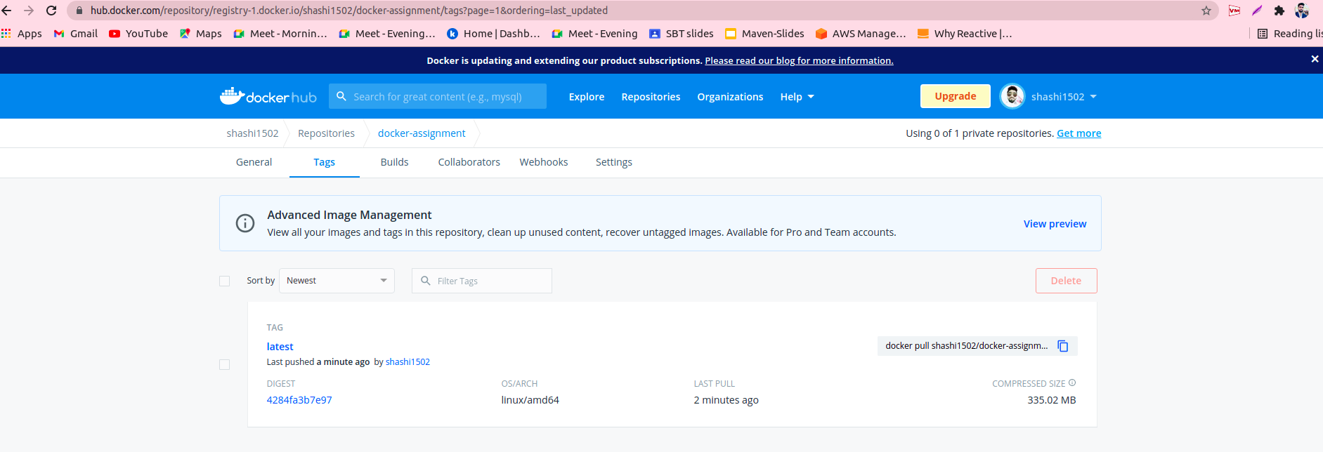

Slide 19
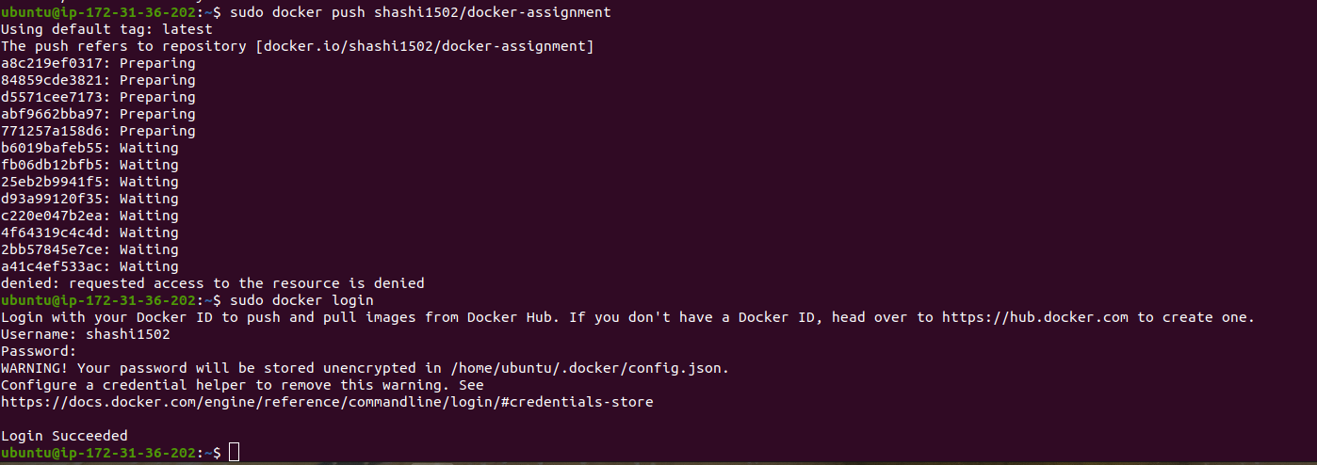
Push all the changes into docker repository and login using command:-
$ sudo docker push<repository_Name of docker>
$ sudo docker login

Slide 20
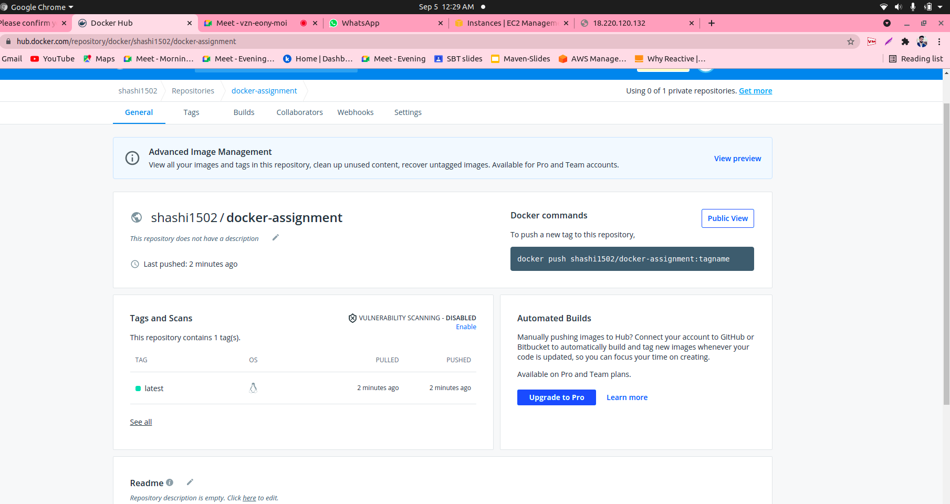

Slide 21
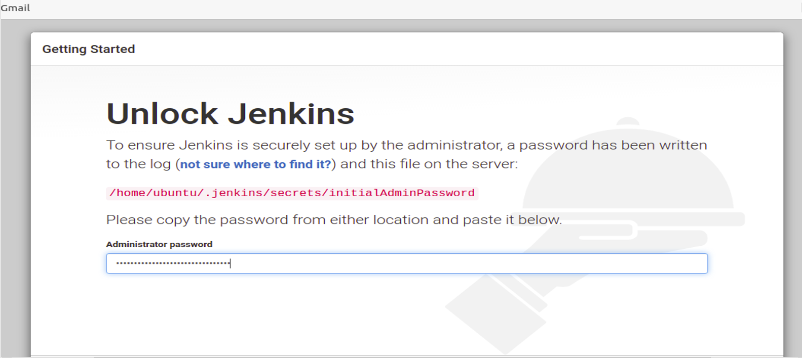
Step 2: Open the browser and open the Jenkins GUI using <IP_VM>:8080.

Slide 22
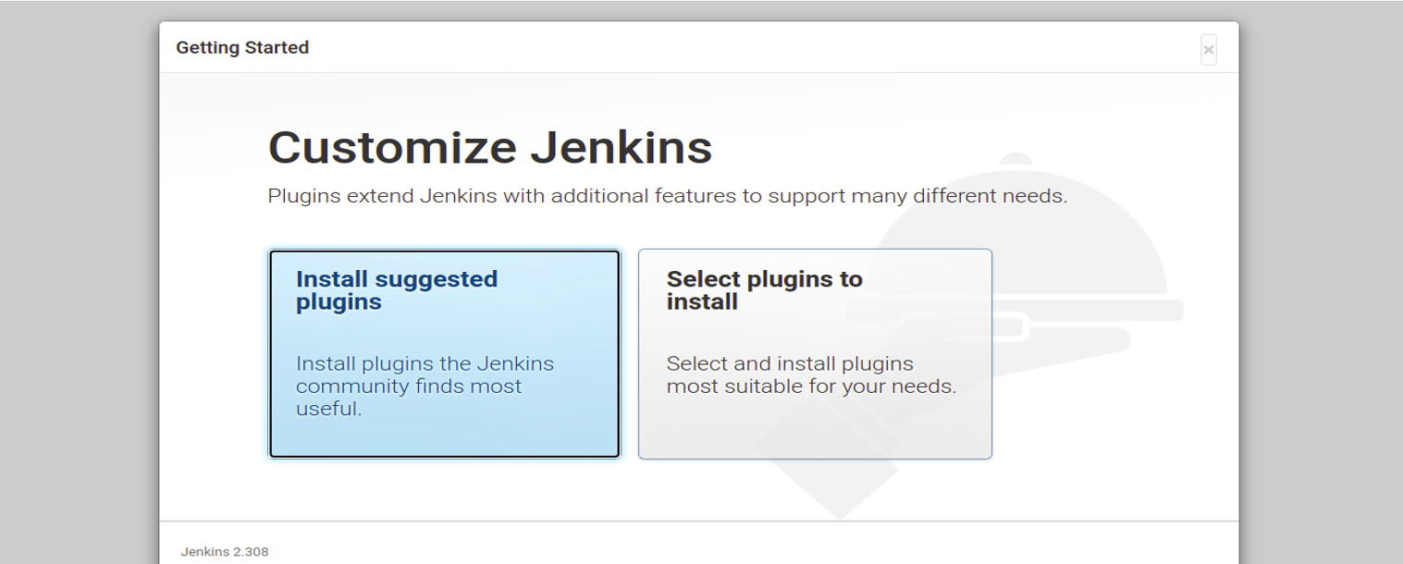
Step 3: Install the suggested plugins and add a account on Jenkins, after that click on start Jenkins.

Slide 23
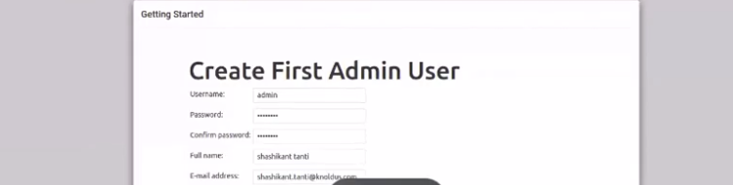

Slide 24
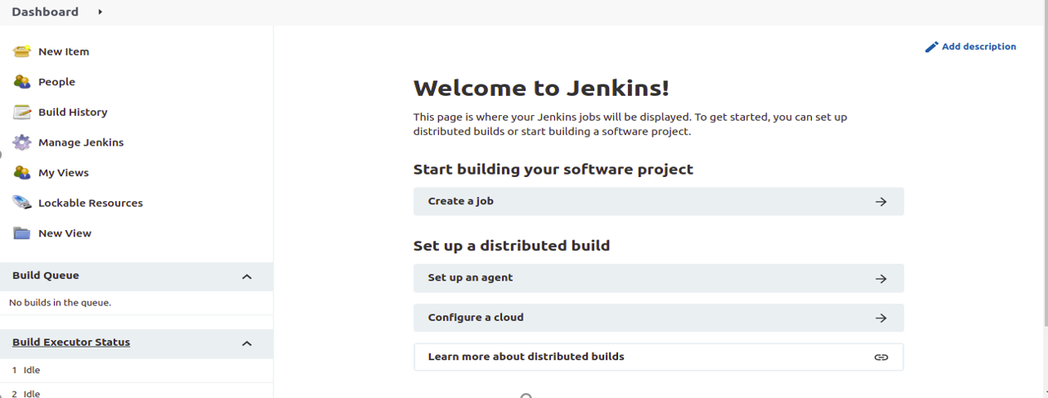
-:Jenkins Dashboard:-

Slide 25
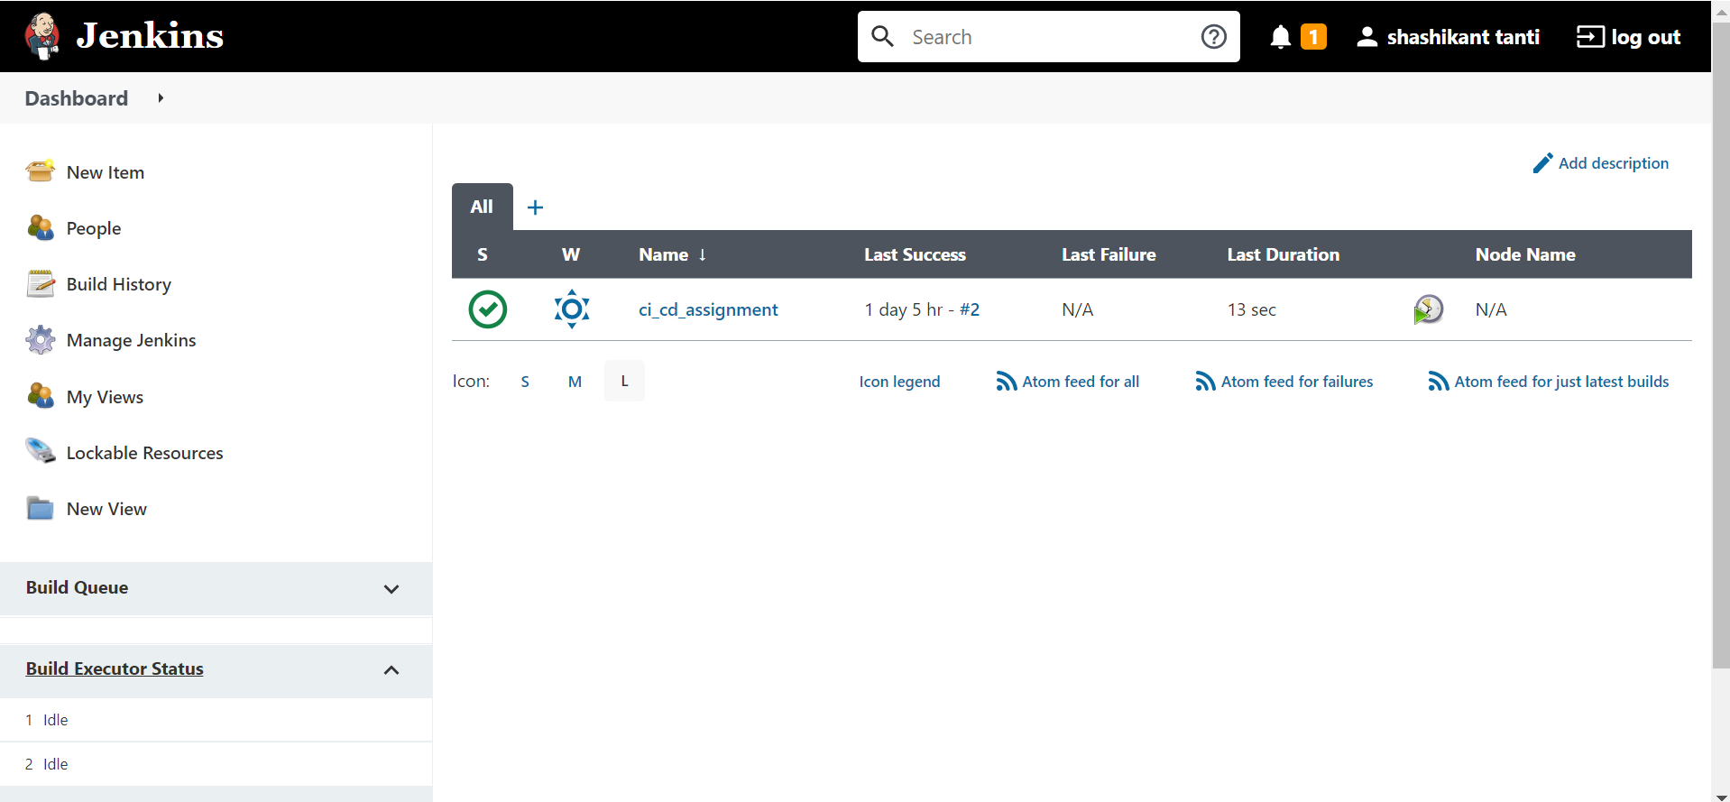

Slide 26
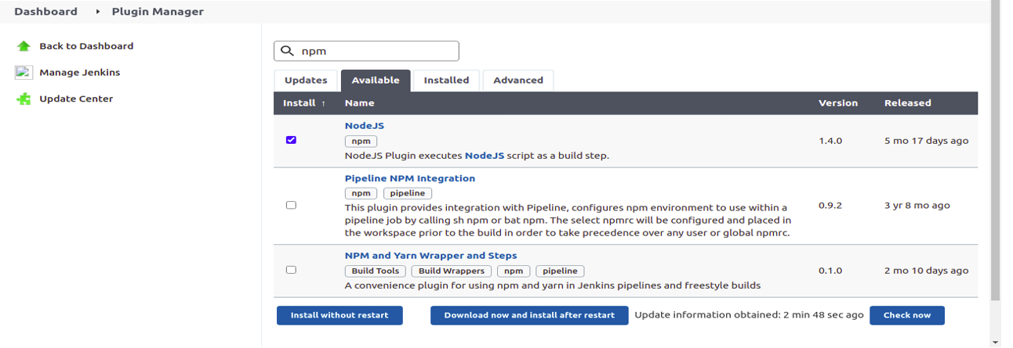
Step 4: Install the NodeJS Plugin and add the global configuration for NodeJS as show in the
figures.

Slide 27
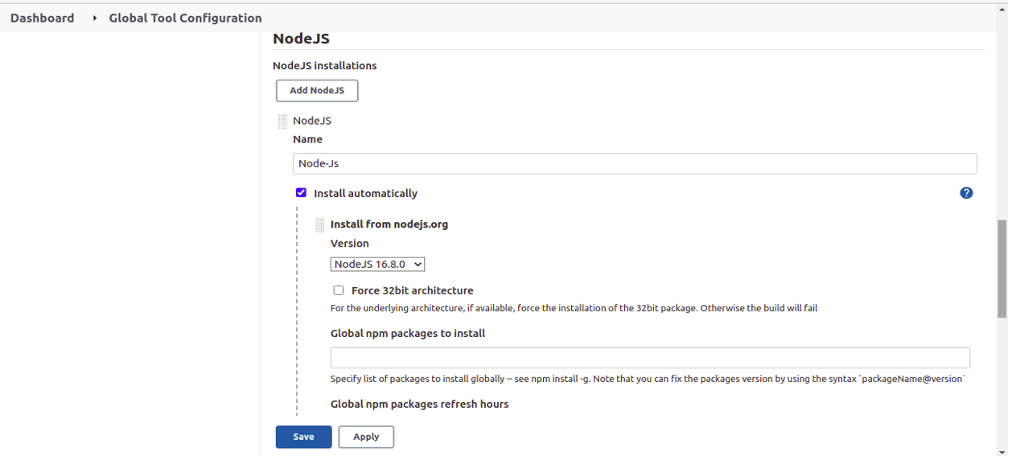

Slide 28
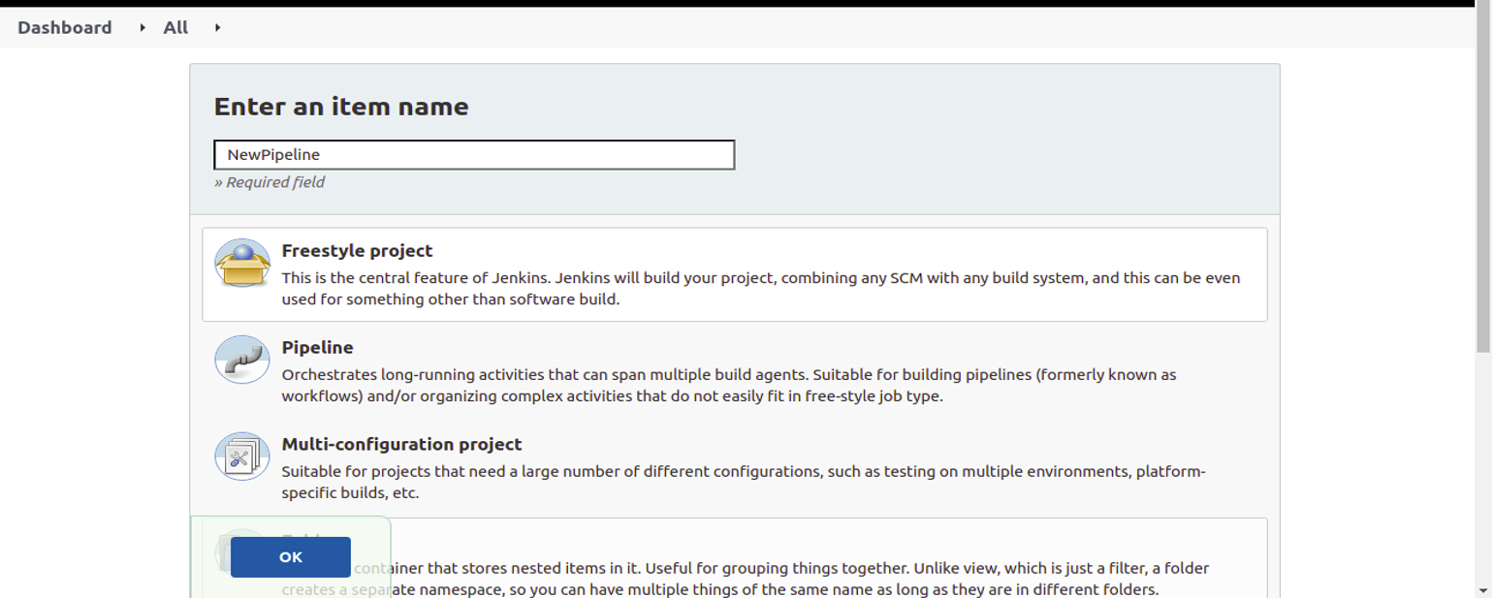
Create a new project of the freestyle type.

Slide 29
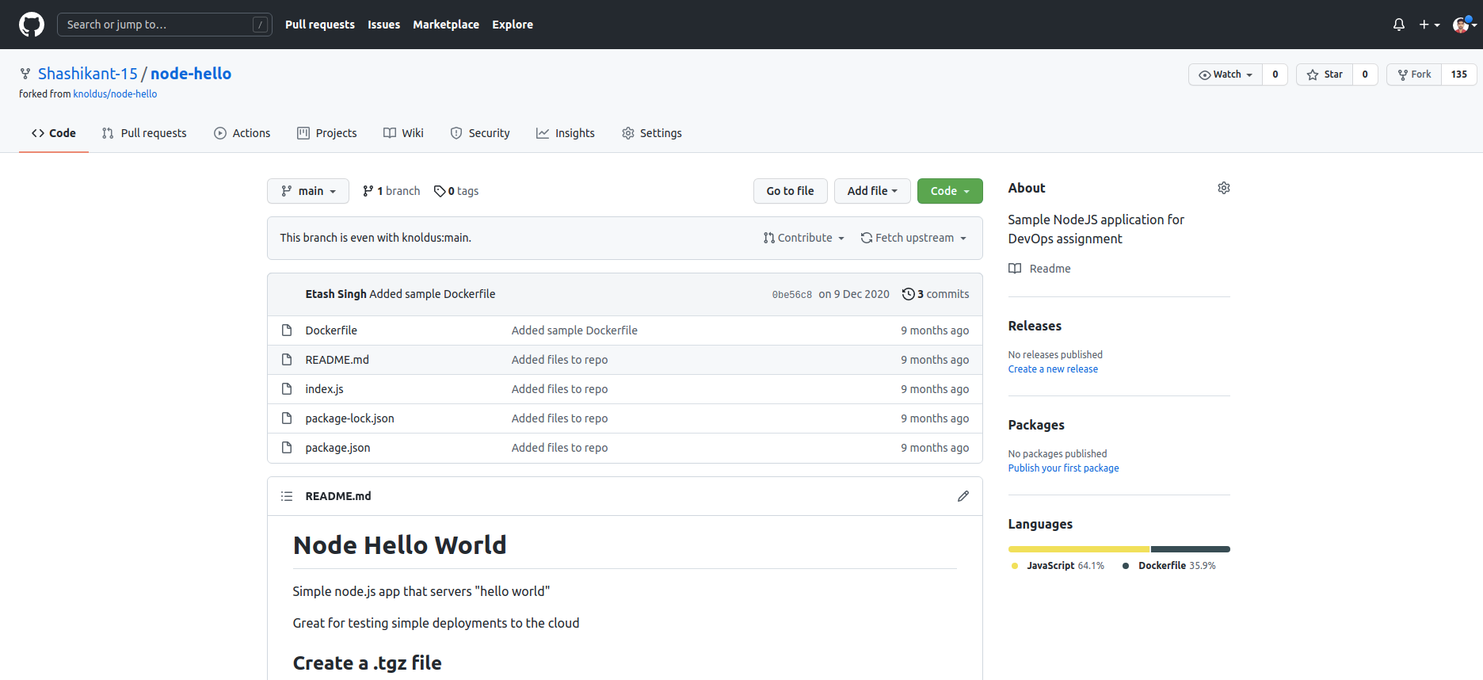
Fork the repository given at https://github.com/knoldus/node-hello into our Github account.

Slide 30
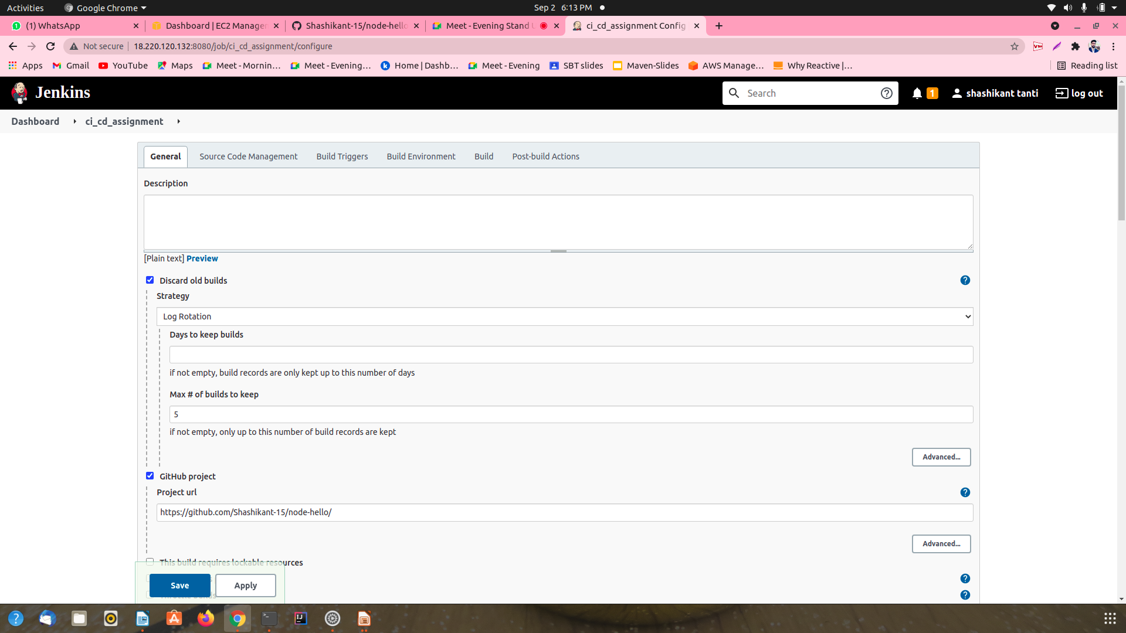
Perform the different build task as shown in the fig.

Slide 31
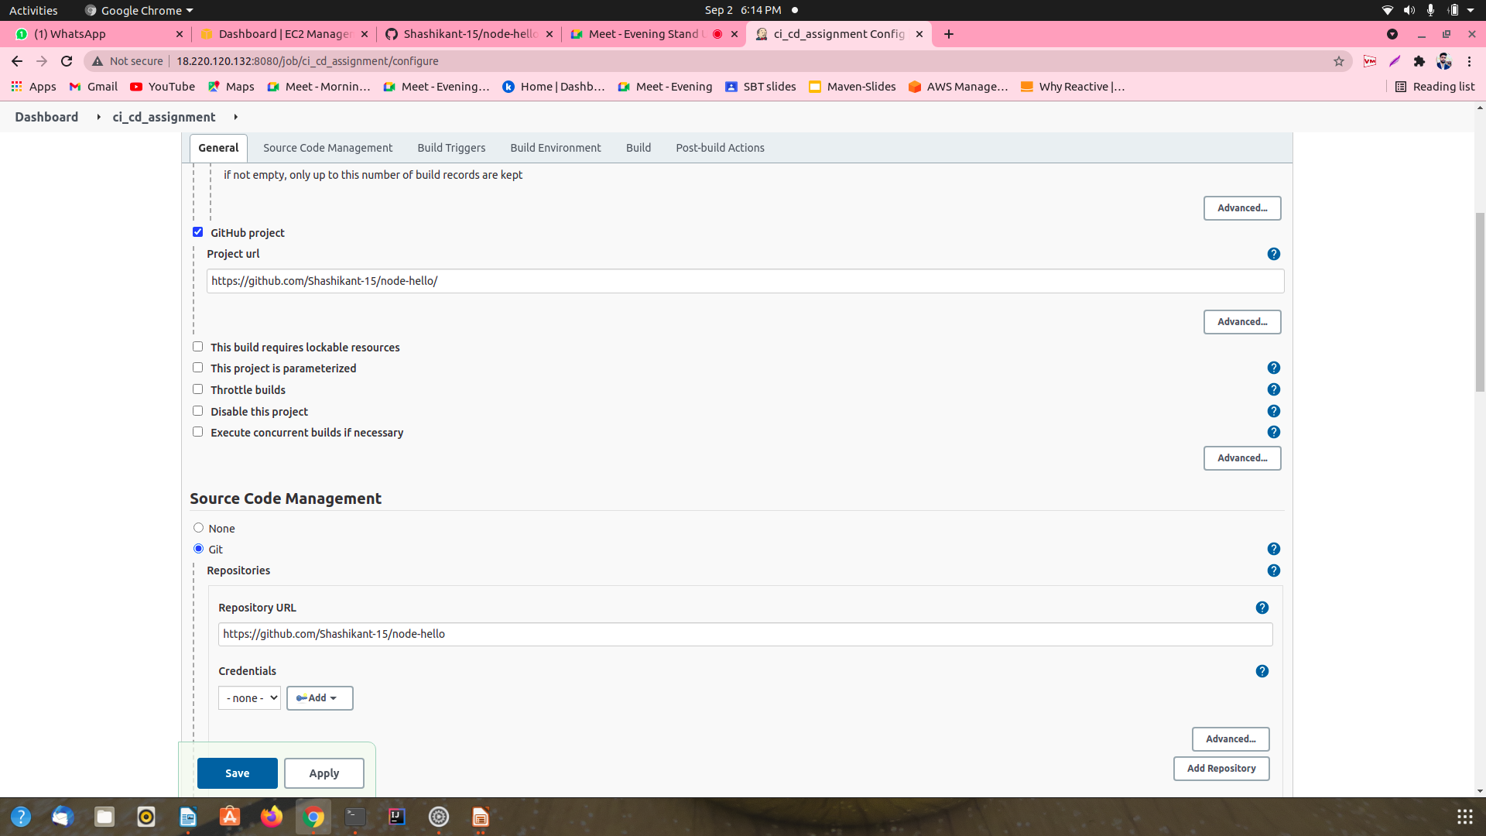

Slide 32
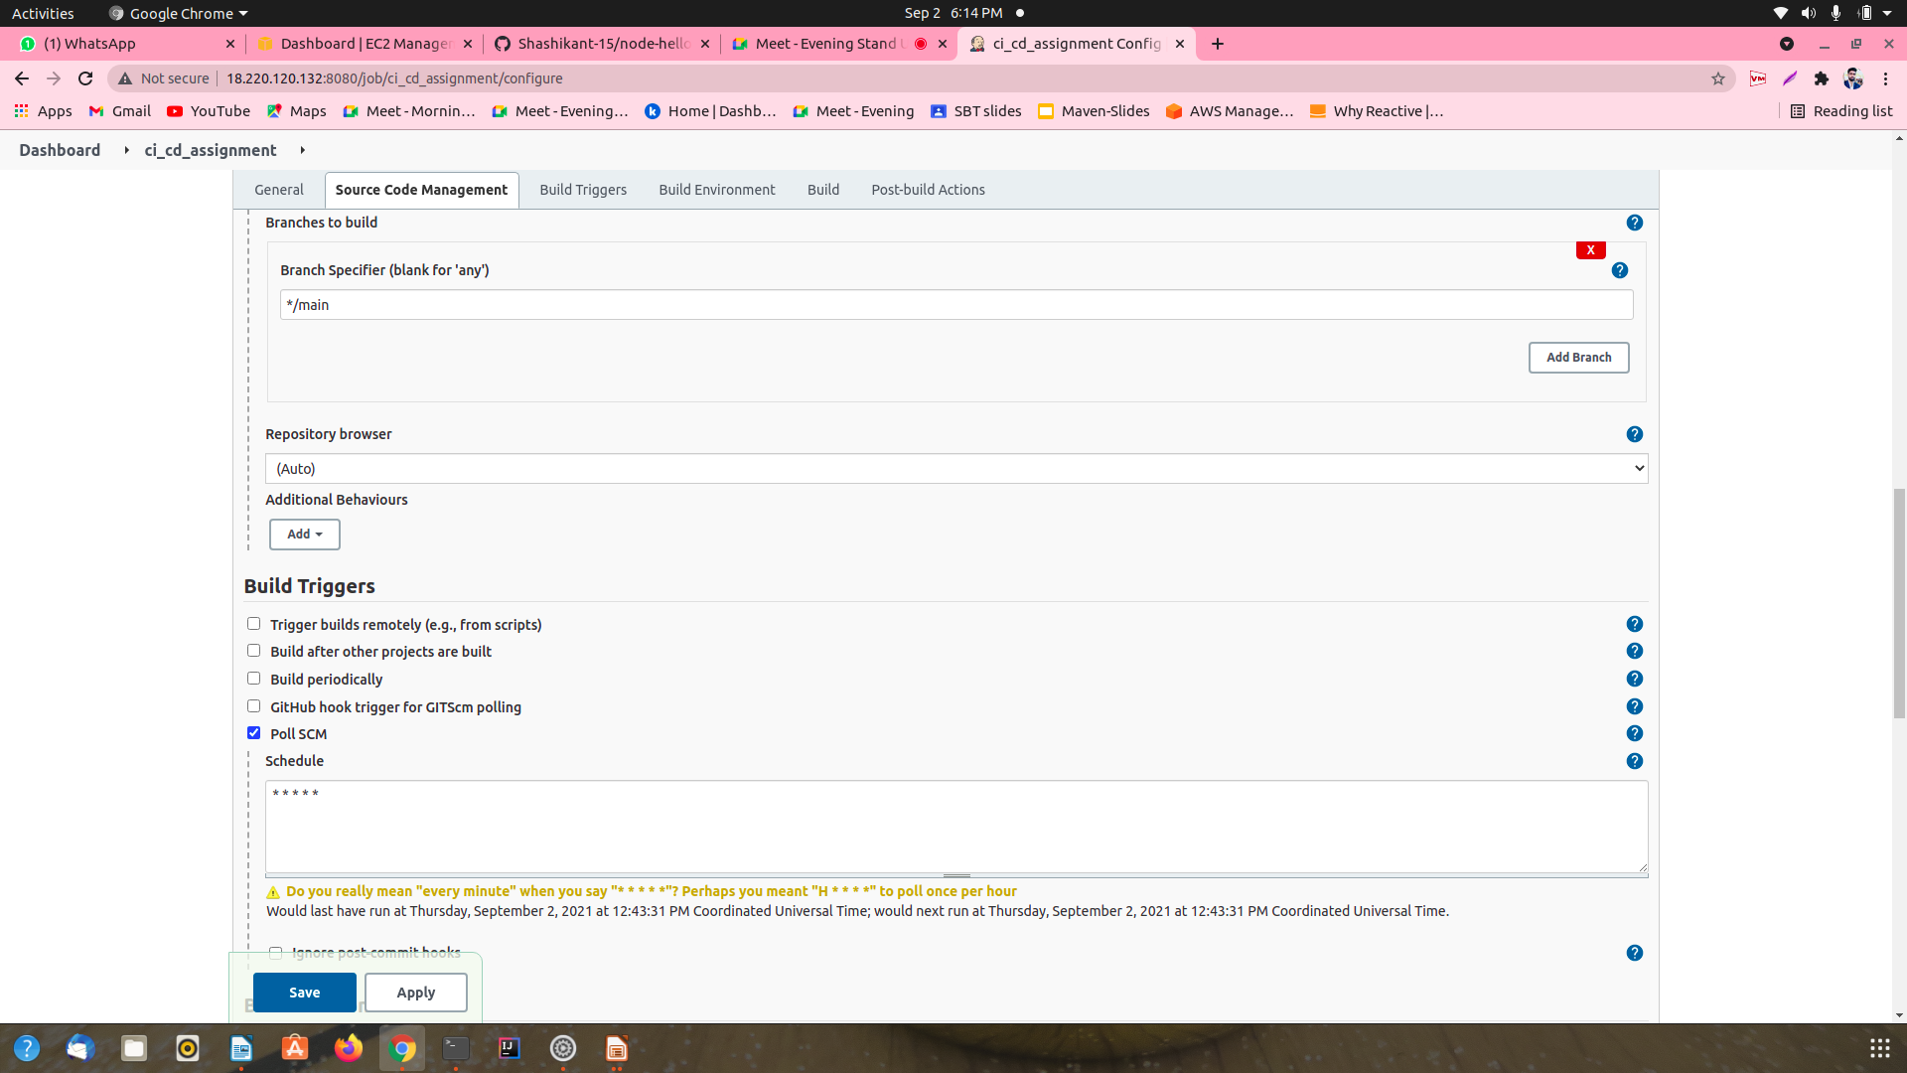
.

Slide 33
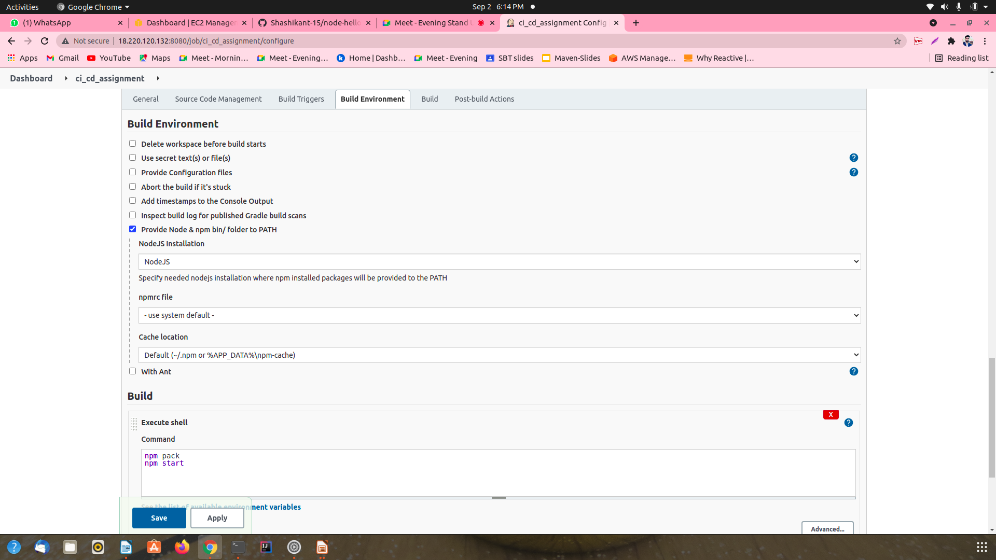

Slide 34
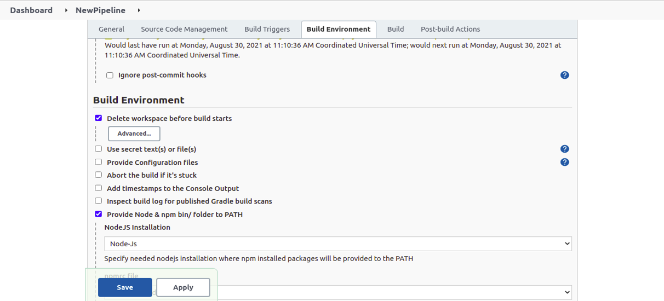

Slide 35
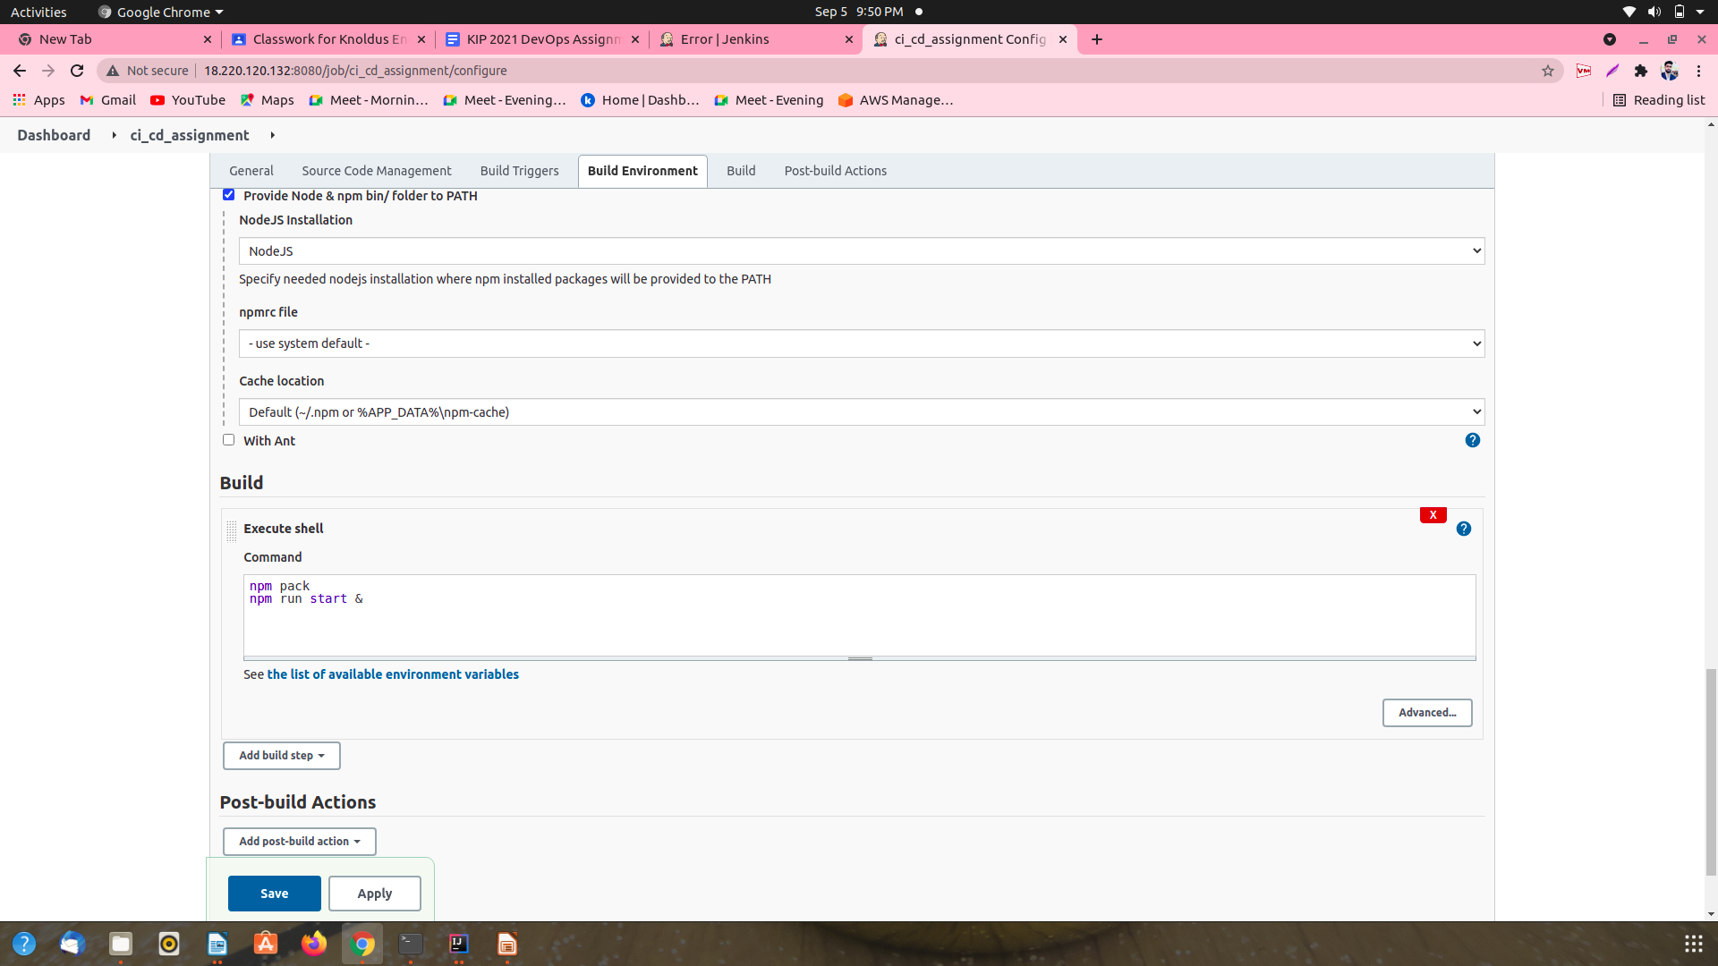
Step 8:- At the end save and apply the required changes.:-

Slide 36
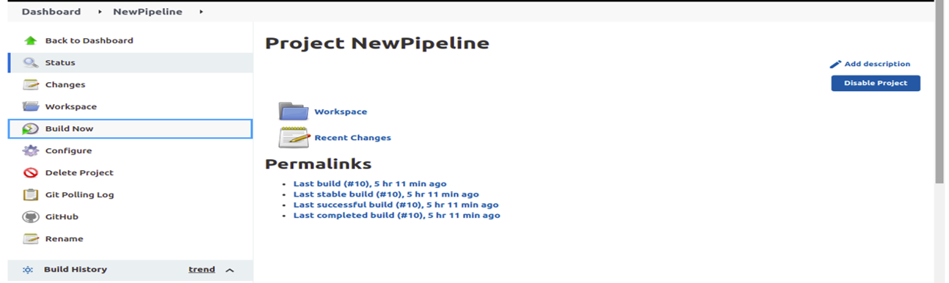
Make a Build
Step 1:- Click on the build now and get proper build in the console.

Slide 37
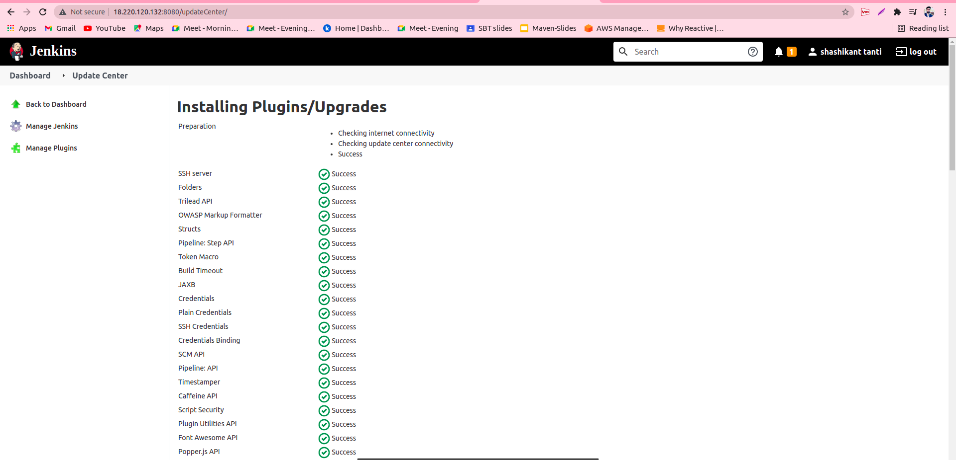

Slide 38
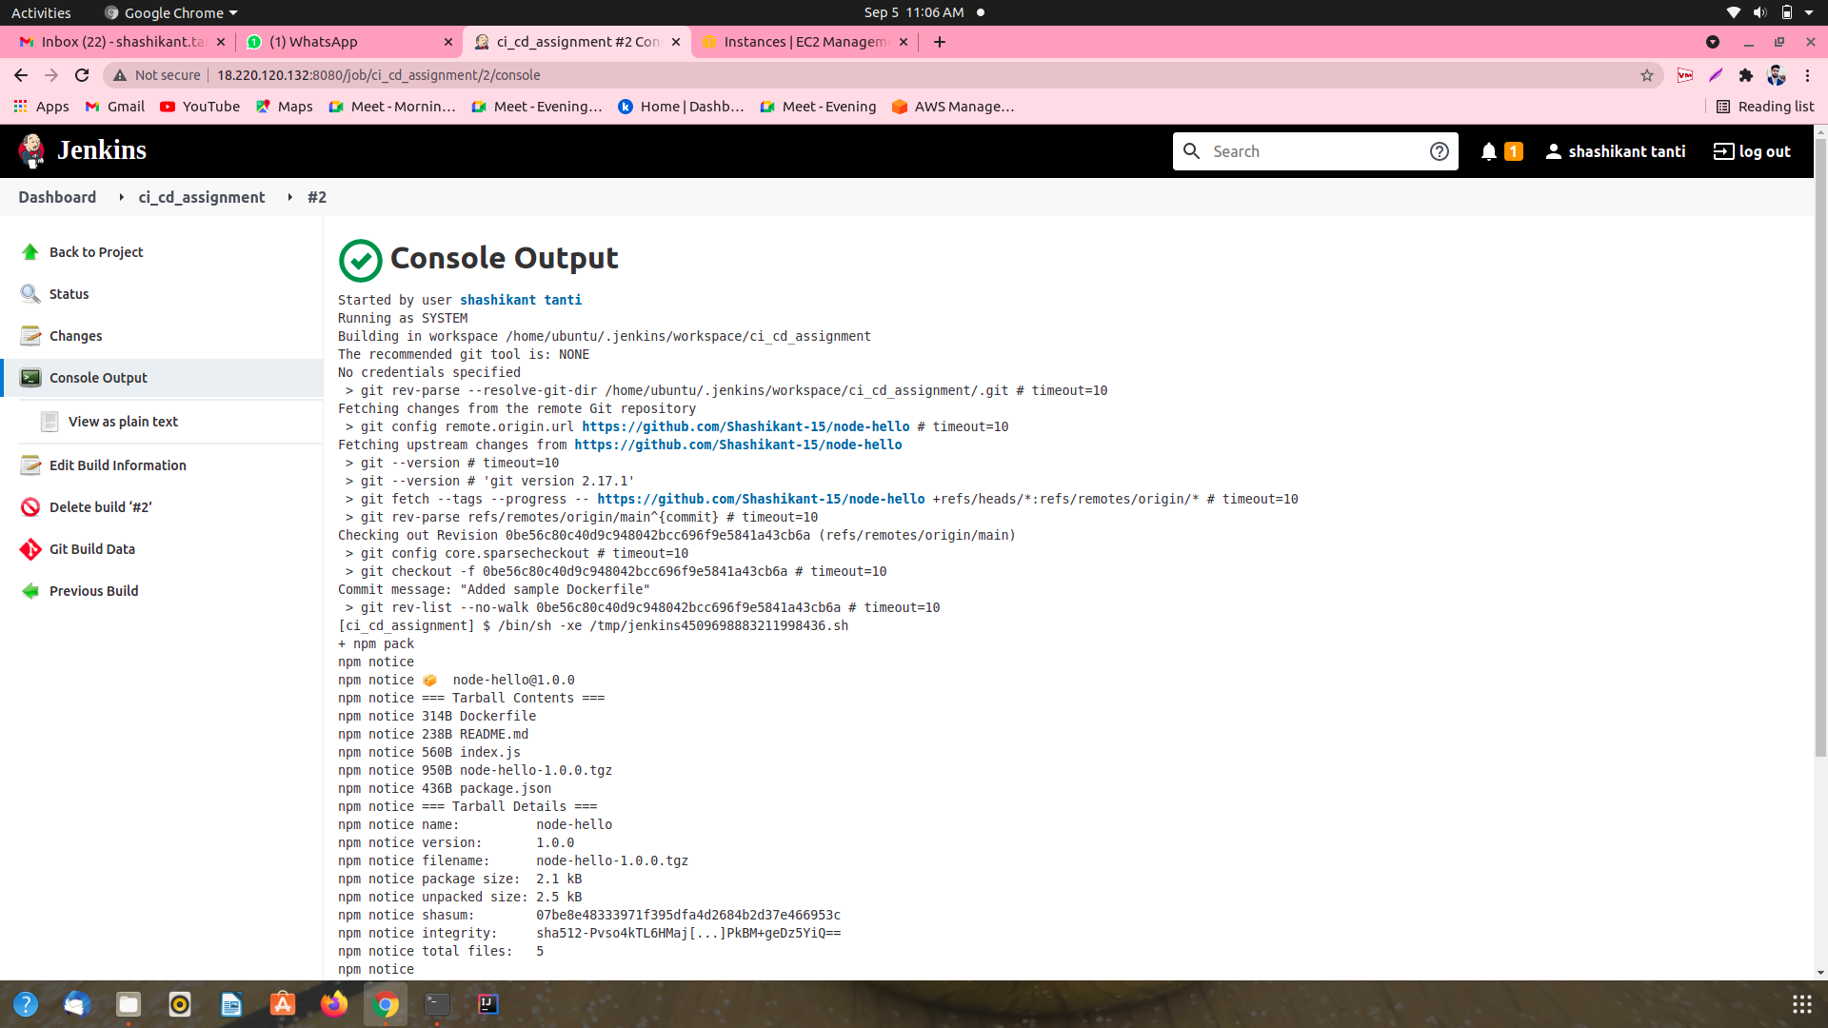
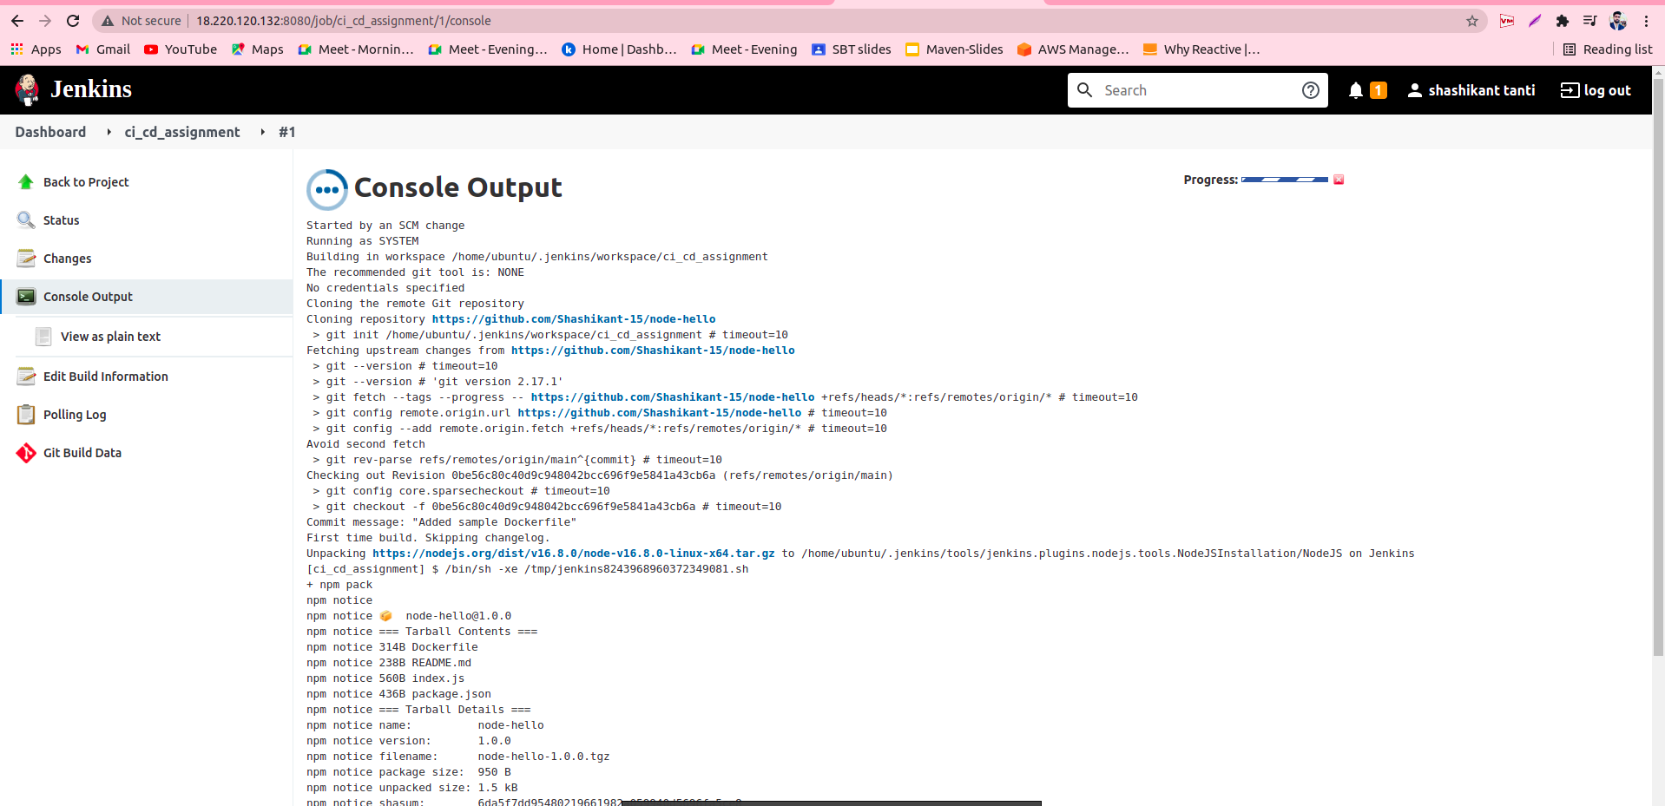

Slide 39
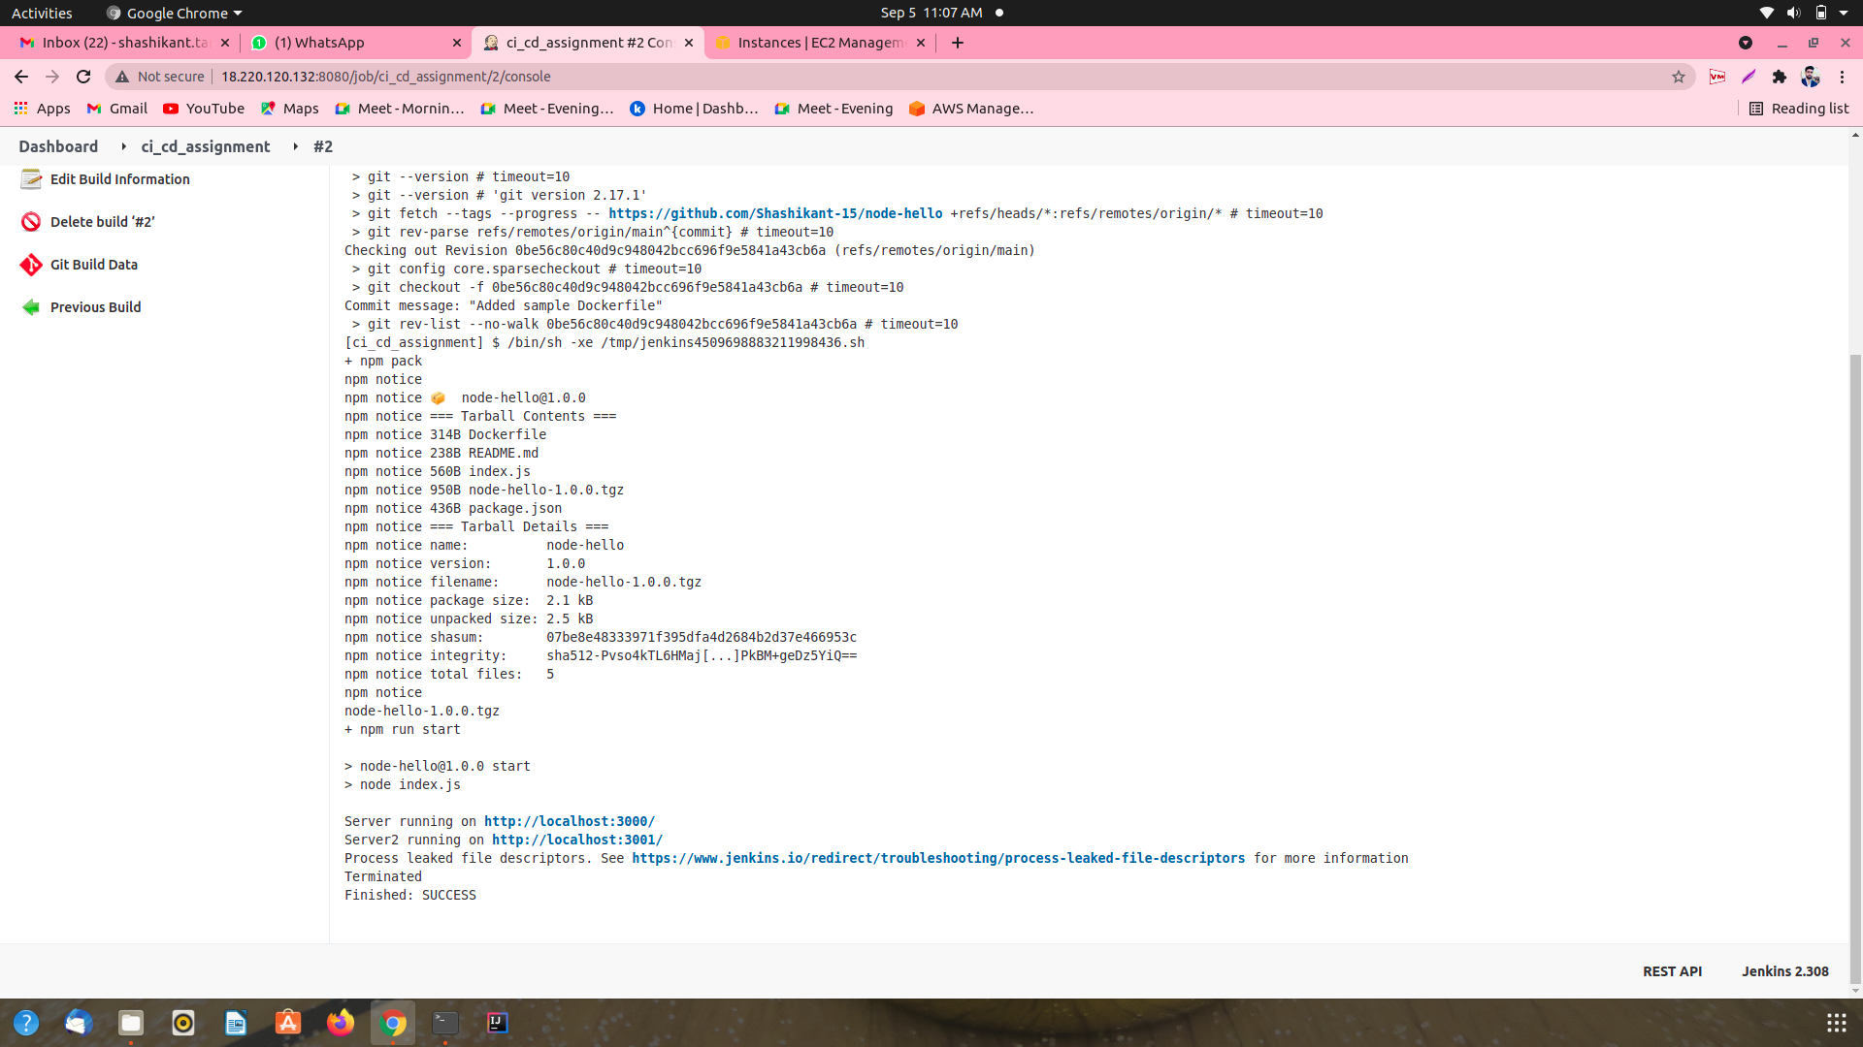

Slide 40
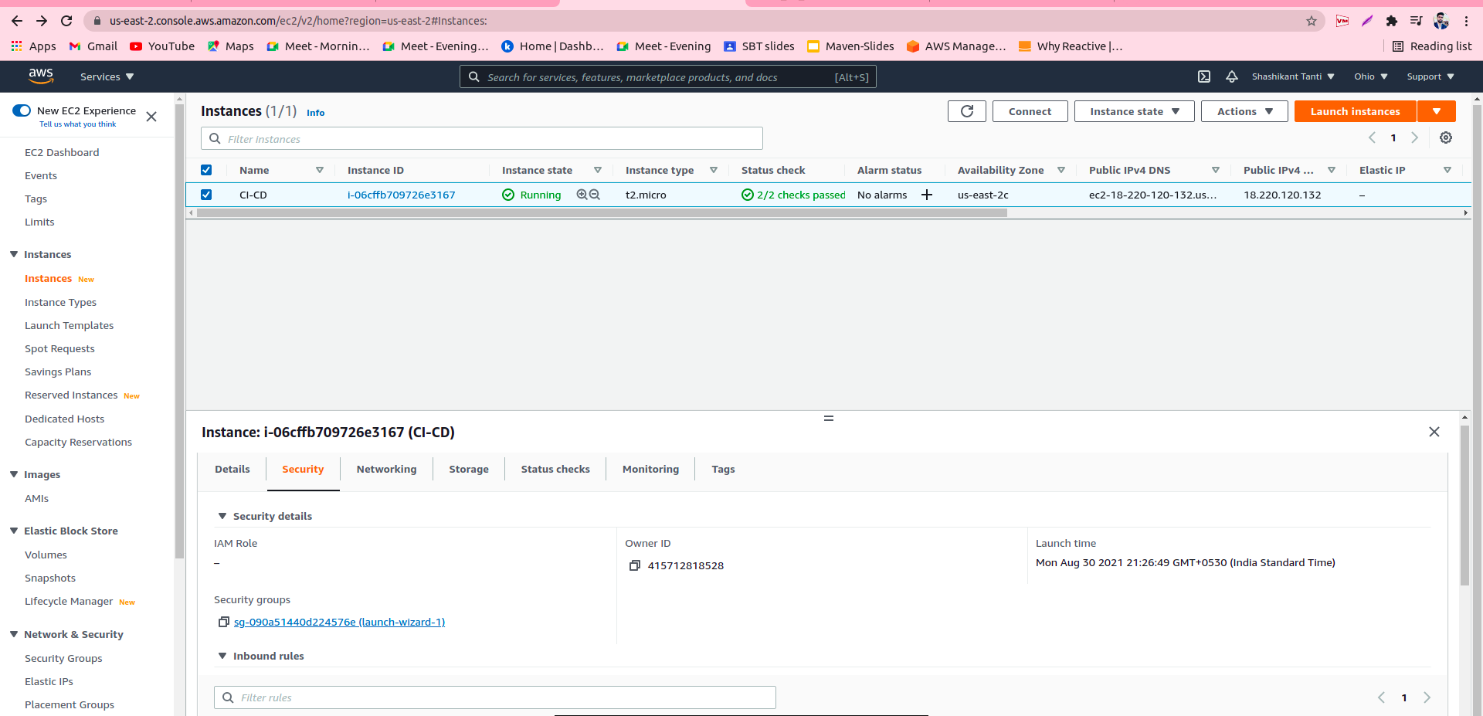

Slide 41
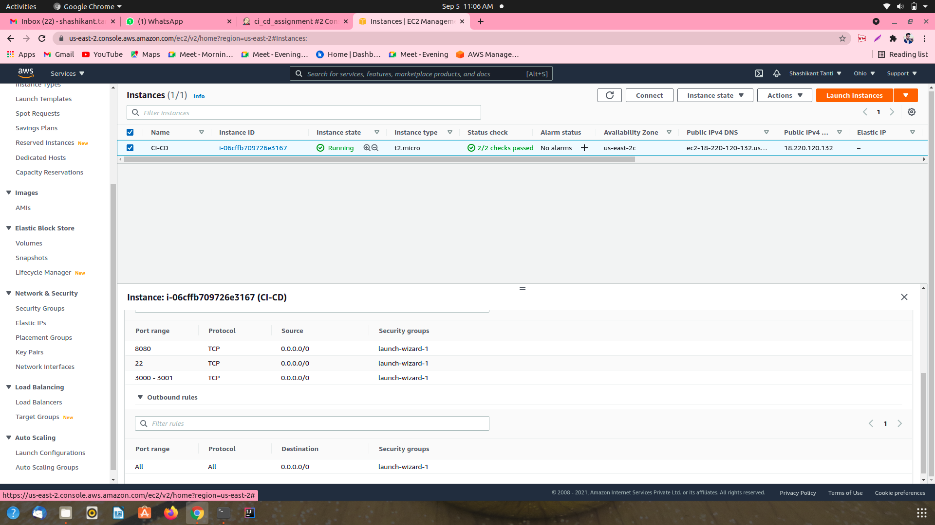

Slide 42
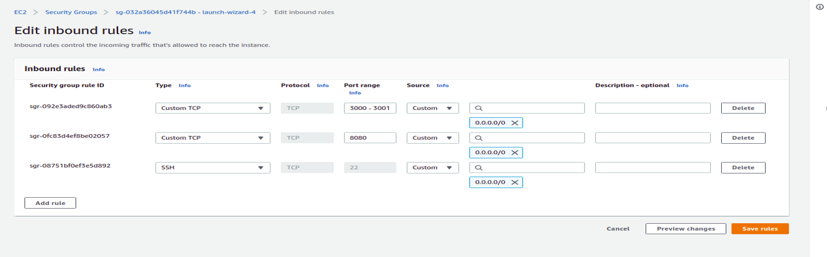
Run Application
Step 1:- Add the port range 3000-3001 in the ec2 instance inbound rules for validation of running app

Slide 43
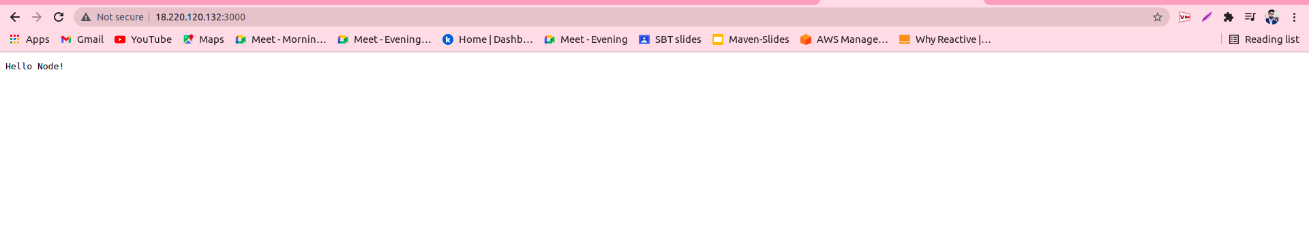
Step2: Launch then <IP_Address>:3000 and <IP_Address>:3001 in the browser for check the app is running on server or not.

Slide 44
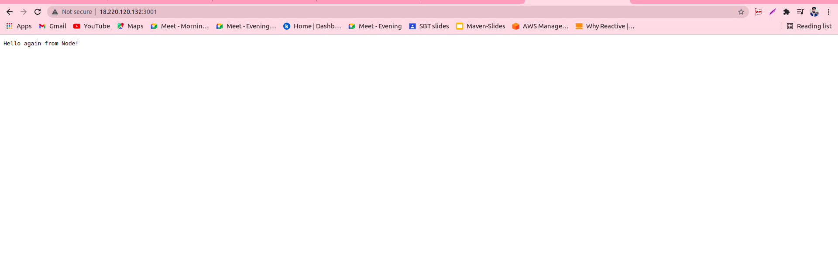

Slide 45

Thank You!

